Slide 1


Silicon Rush
Proposal
Team Phoenix
<A Sakthe Balan, PES1UG21CS002>
<Adithya S K, PES1UG21CS033> <Keerthan Gopalakrishnan, PES1UG21CS273>
<Sarthak S Kumar, PES2UG21CS482>

Slide 2
Problem Statement
Smart Home Infrastructure
1)Energy efficiency has tremendous potential to boost economic growth and avoid greenhouse gas emissions and prevent erratic climate changes, but the global rate of progress is slowing – a trend that has major implications for consumers, businesses and the environment
2)During the lockdown of Covid-19, many people started indoor gardening as a hobby. Now that they have to return to work, they generally forget to nourish and water the indoor plants. Taking account of this, design a smart application that monitors the soil moisture and intensity of sunlight falling on plants at regular time intervals.

Slide 3
Solution Appendix
We have come up with two solutions to solve the mentioned problem statements.
1)Our product shakthi is connected to a web application and an mobile application which allows the user to observe and control the electrical appliances in the most effective and compact method thereby allowing the user to take complete control over his appliances.It is an ergonomically designed product for home use ,it comes with a built in universal socket which supports every appliance connected
Video:https://youtu.be/kS_2ZGTF39I (the prototype is partially built but we need to make a lot of improvements)
2)Terragrow is an ecosystem of smart gardening products which seamlessly integrate with one another to provide a robust solution for all sorts of customers. Terragrow consists of multiple devices which aid and support the growth and development of plants.
We have built a web application which links all the devices and allows the user to to view and control these devices effortlessly and from any location
Video:https://www.youtube.com/watch?v=0BbxqXT93II

Slide 4
Solution(Shakthi)
01
02
03
03
03
03
Set Up Shakthi
Connect the appliance of your choice
Sit back and automate
Just have to plug the device in and connect it to the app
You can remotely switch on and off the device anywhere from the world
You can connect any device to the other end, it can either be a fan , microwave,tv , light,washing machine
Monitor the power consumer by your device using that the app will also predict electricity bill of that particular device
You can also add additional sensors like PID so that it can detect motion and can switch on the device as soon as you enter the room
The time at which the device can be turned on and off can be set through the app(scheduling)

Slide 5
Solution(Terragrow)
01
02
04
03
It involves a special feature of water recycling. It involves a mechanism consisting of a semi-permeable layer below the soil base, which enables re-use of irrigated water, using a irrigation preset, hence preserving essential nutrients of soil, which is usually washed away in current irrigation systems. It also helps in eliminating breeding of insects in stagnant water left below pots, hence preventing threatening diseases.
Plantic is a smart plant probe that gives your plants a voice and it helps you to look after your plants in smart way. It can measure soil moisture, light intensity, temperature and other essential parameters. The probe connects your plants with your device so that you get real-time updates and will be able to monitor. The interface compares measurements from the probe with a database consisting of plant data and accordingly notifies you whenever your plan needs to feed or water. It will offer you educational tutorials and other content i.e an Information System which will inspire you to take care of your plant and know more about it.
Hydromo will help you take care of your house plants with great ease. It is a smart watering system to water plants when necessary and controls just as much water as need to grow the plant's growth. Hydromo integrated with Plantic, can help monitor plant health in real time and track essential parameters and irrigate the plants accordingly. It can detect when your plants need to be watered so you can go for a business without worrying about your plants.
Exagrow is a all in one system for smart indoor gardening. We will be combining the technologies implemented in the plantic probe, hyrdromo water system and vertivy gardening system along with a few other technical features and optimisations. Some of the notable features of Exagrow could be Real-Time Monitoring, Water Irrigation System, Nutrient Control, Information System, Connectivity and User-Friendliness. It is a go to robust solution for urban industrial smart gardening requirements.
Vertivy helps you to grow a garden full of plants all year around and create your own personal urban garden inside and outside of your home. It allows you to grow plants taking only a few square feet of space. So you can feed it anywhere in your home easily. It has a low pressure aeroponic design that aids better growth of plants in comparison to soil gardening or traditional hydroponics. It also provides the roots with enough oxygen to develop into healthy and strong plants the aeroponic design helps to enter more oxygen into the roots, hence enables the accelerate growth of plants. It also gives you pesticide free gardening experience, hence a safer experience while gardening. Vertivy comes along with low maintenance and require less work and human intervention than traditional gardening.

Slide 6
Requirements
Software stack
Hardware
-HTML , CSS , tailwind css , react ,django, mysql , firebase , blynk
-Arduino IDE
2 * ESP32
Temp and humidity sensor
Solid moisture sensor
Battery(LIPO)
Relay module
Voltage sensor
Current sensor
Sockets
Speaker module
Light sensor
Water pump
Acrylic tube

Slide 7
Deployment(Shakthi)
We will be targeting people who want to make their home infrastructure smarter at an affordable rate and also make it more modular as a single shakthi plug can be used with multiple devices.
It is comparatively easy to deploy shakthi as it is an universal socket which supports every appliance connected and displays the current and voltage to the user effortlessly.
Our solution is better because it allows you to make any appliance smart and dynamic just by connecting it to the socket we provide, whereas current day innovations have it prebuilt with certain appliances only.

Slide 8
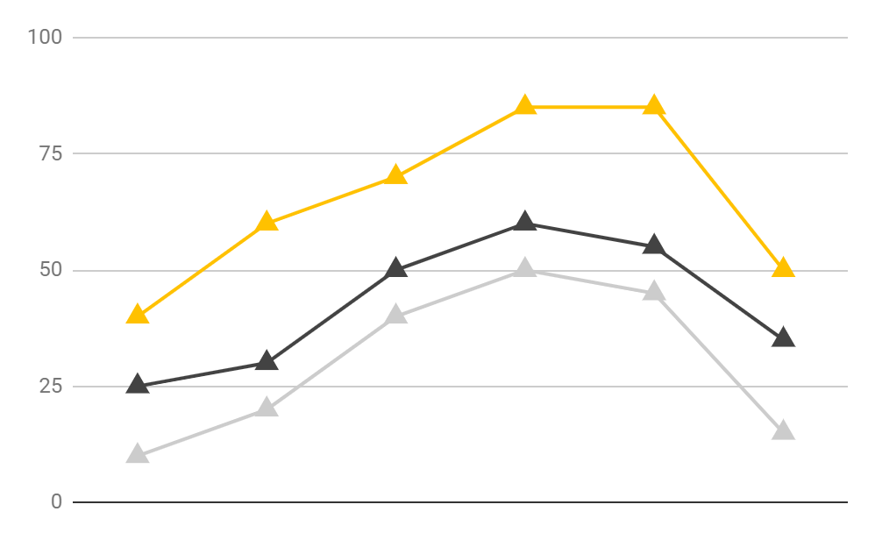
Deployment(Terragrow)
People getting into indoor gardening
People who want to grow plants to sustain some of their needs(abit indoor gardeners)
Urban farming industries
Our ecosystem has a product for every one
-Plantic - for people who want to get into indoor gardening
-Hydromo - for people who have experience with indoor gardening and want to up their yield.
-Exogrow - for industries Our solution has a ecosystem build around it and can be customised according to the users needs

